Slide 1








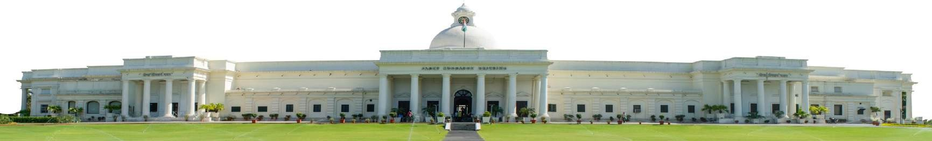



IIT Roorkee: Adapting to Global Change
INDIAN INSTITUTE OF TECHNOLOGY ROORKEE
Karun Rawat
Dean, International Relations
Professor, Electronics & Communication Engineering
Indian Institute of Technology Roorkee
Roorkee, 247667, Uttarakhand, India
E-mails: dean.ir@iitr.ac.in, karun.rawat@ece.iitr.ac.in
iitr.ac.in

Slide 2
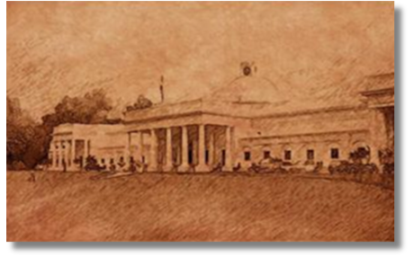
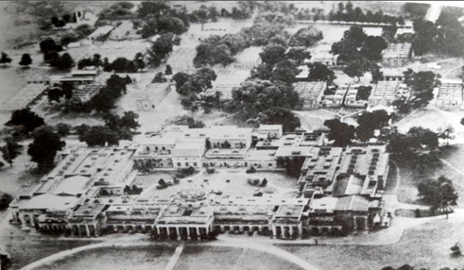
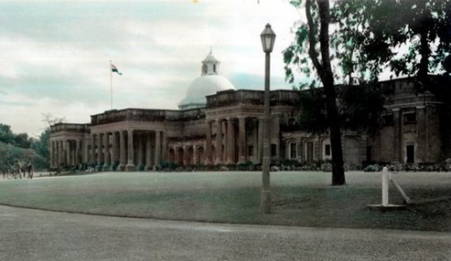
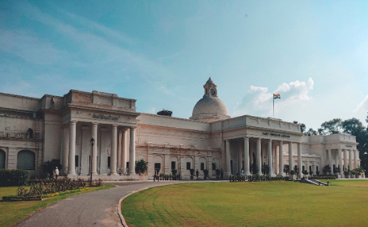

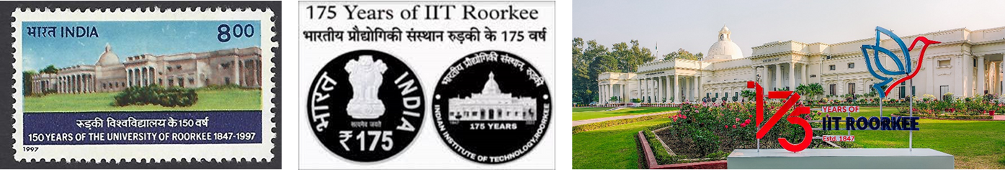
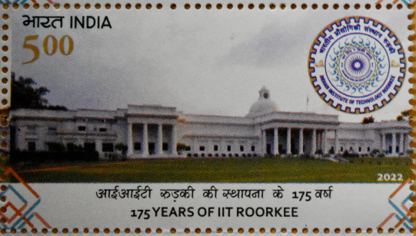
History and Journey
177+ Years of Excellence
1847
1854
1949
2001
The Roorkee College
(1st Engineering College in British India)
The Thomason College of Civil Engineering
University of Roorkee
(1st Engineering University of Independent India)
Indian Institute of Technology Roorkee
(declared as Institute of National Importance in the 150th Year)

Slide 3

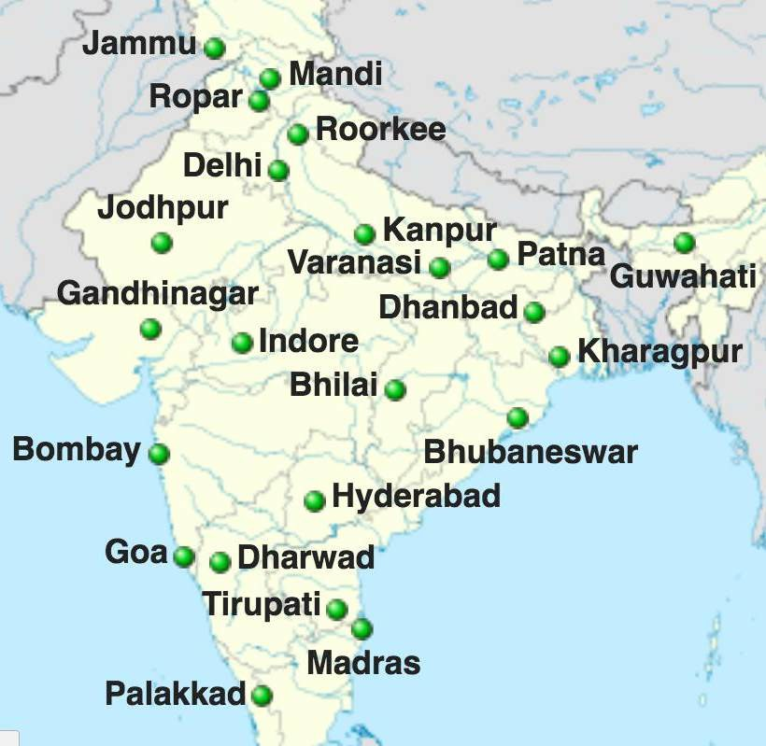
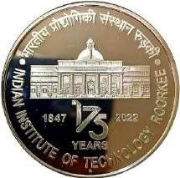
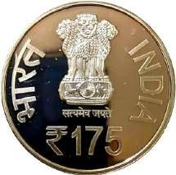
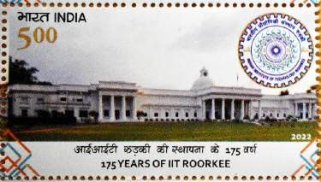

IITR@178 years
IITs are autonomous public institutes of higher education
Governed by the Institutes of Technology Act, 1961 which has declared them as
institutions of national importance
  Origin: 1847
  Govt of India Celebrated 175
Years of IIT Roorkee in 2022 by releasing commemorative Coins & Stamps
339
Parameter | World Rank
Citations per Faculty | 61
Engineering & Technology | 131
Employer Reputation | 234
Natural Sciences | 308
1
2

Slide 4
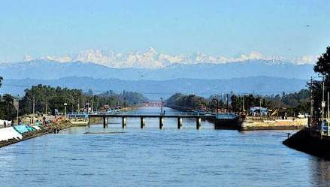
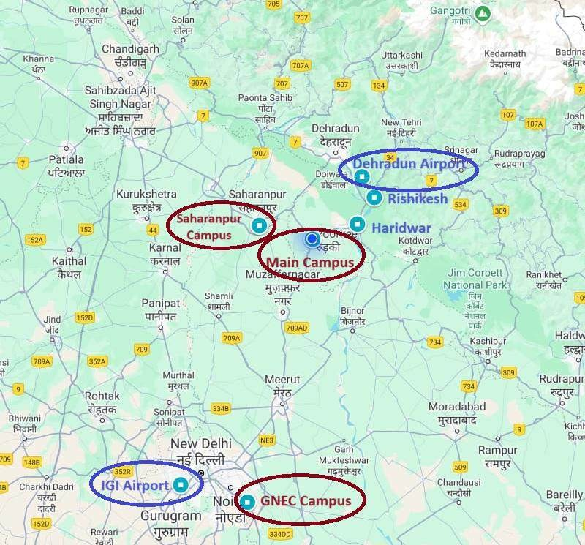

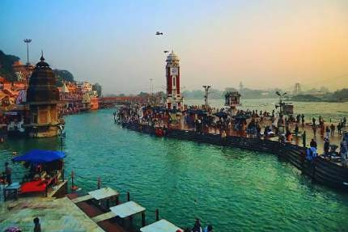
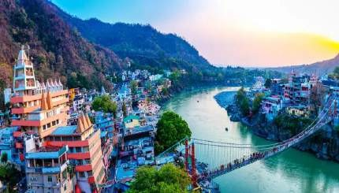
IIT Roorkee - Campus
Roorkee
Haridwar
Rishikesh
New Delhi to IIT Roorkee ➔ 3.5 h (Train/Cab)
3

Slide 5


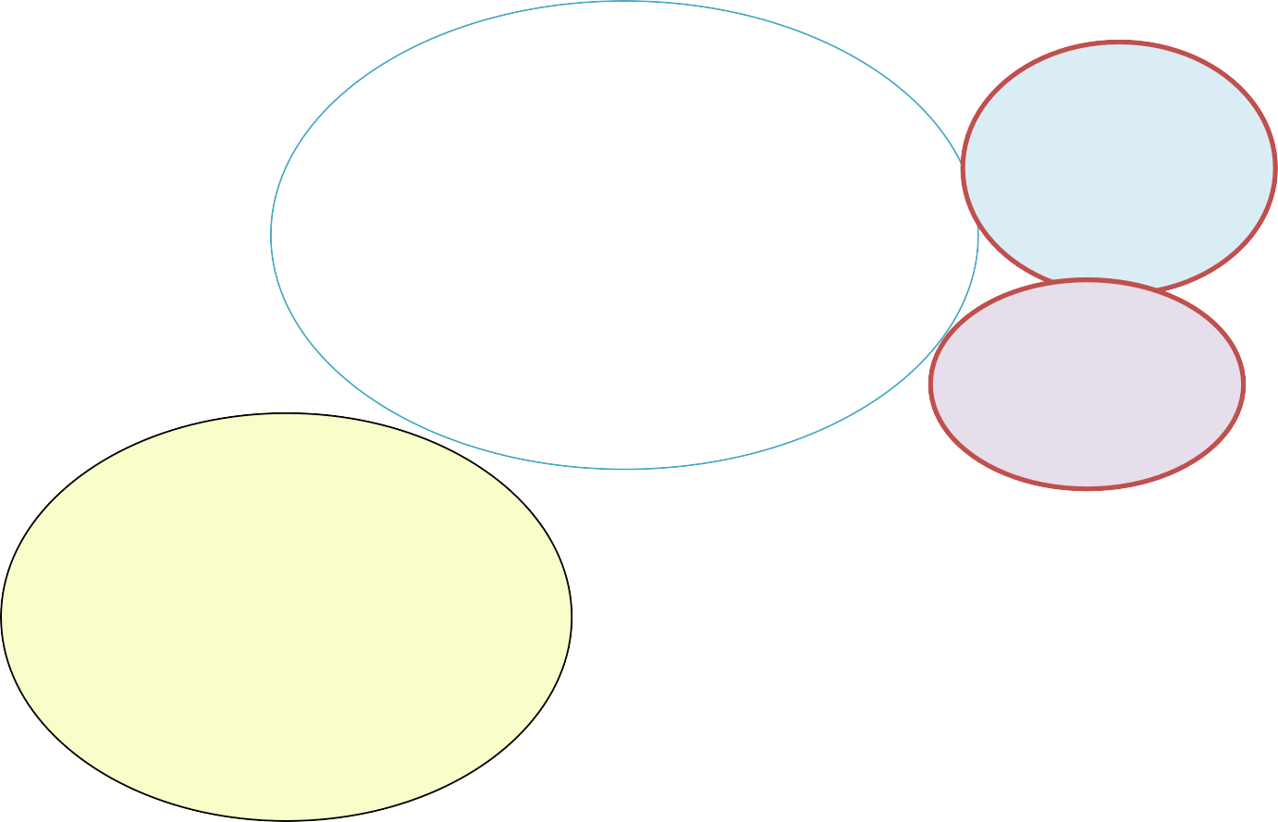

IIT Roorkee: At a Glance
All courses taught in English.
Fully residential campus with all possible facilities.
Extensive sports facilities and clubs for co-curricular activities.
>570
Faculty
members
365 Acres at Roorkee
10 Acres at Gr. Noida, Delhi
>1200
Staff
IIT ROORKEE: AN OVERVIEW
25 Acres at Saharanpur
Three Incubators
200+ Startup
Academic Programs
Undergraduate (UG): 17
Postgraduate (PG): 65
PhD: 36
Students: >10700
UG: 5000+
PG: 2000+
PhD: 3700+
Research Data for 2024
Publications: 3000+
Patent: 220+(A) + 120+(F)
Grants: 4.5 Billion INR

Slide 6



Departments
QS Rankings of the
Departments in Brackets
All Departments have PG and PhD programs
Yellow color is for Departments having UG programs
Chemical Engg (151-200)
Civil Engg (101-150)
Computer Science and Engg (201-250)
Electrical Engg (151-200)
Electronics and Communication Engg (151-
200)
Mechanical and Industrial Engg (151-200)
Metallurgical and Materials Engg (151-200)
Hydro and Renewable Energy
Hydrology
Water Resources Development & Management
Earthquake Engineering
Paper Technology
Polymer and Process Engineering
14. Architecture and Planning (150-200)
15. Design
Biosciences and Bioengineering
Chemistry (351-400)
Earth Sciences
Physics (351-400)
Humanities and Social Sciences
Mathematics (201-250)
Applied Mathematics and Scientific
Computing
Management Studies (251-300)
School
1. Mehta Family School of Data Science and Artificial Intelligence

Slide 7

Academic & Research Centres
Research Centres
Sustainable Energy
Sustainable Rural Development
Indian Knowledge Systems for Holistic Advancement
Nanotechnology
Semiconductor Design and Technology
Photonics & Quantum
Communication Technology
Space Science & Technology
Transport Systems
Disaster Mitigation & Management
International Centre for Dams
Drone Research
Railway Research
Petrochemicals
Automotive and Allied Technologies
Honey Authentication and Food Safety
Adaptation, Disaster Risk-Resilience and Sustainability (ICARS)
DRDO Industry Academia - Centre of Excellence (DIA-CoE)
Academic Service Centres
Continuing Education Centre
E-Learning Centre
Greater Noida Extension Centre
Institute Computer Centre
Institute Instrumentation Centre
Mahatma Gandhi Central Library
iitr.ac.in

Slide 8



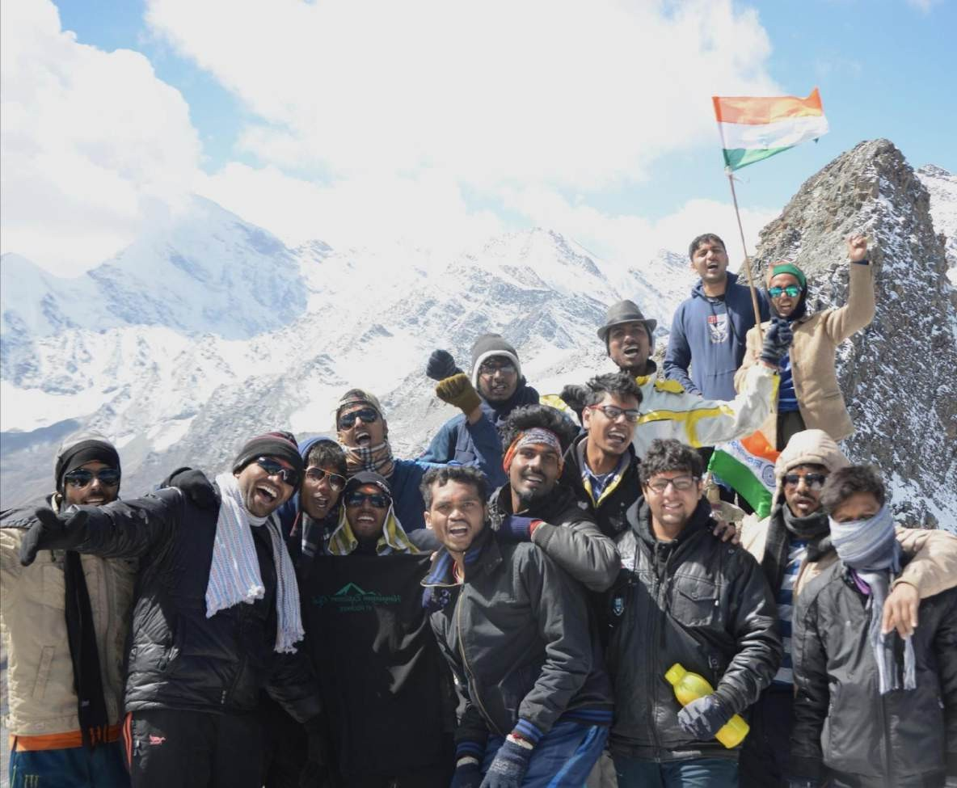








Evolution & Elevation
The IIT Roorkee ranked no. 1 (among all IITs) in enrollment of the highest number of international students
1st in Architecture, 5th among all Engineering Institutions & 7th overall, as per the NIRF Ranking, 2024
50+ On-campus Student Clubs, 15+ Sports Facilities
In-campus Accommodation & Medical Facilities
One of the best-performing Institutes in terms of placements (>90% for UG; >70% for PG)
iitr.ac.in

Slide 9
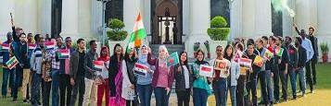

International Relations and Internationalization
iitr.ac.in

Slide 10





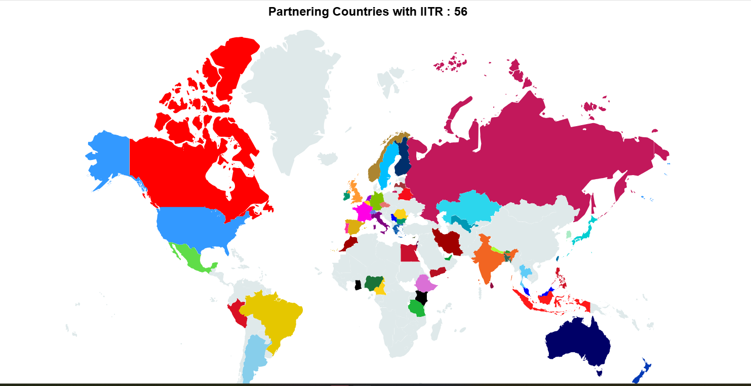
Internationalization @ Home
300+
International Students
1500+
Applica tions Received
80+
Countries ( International Students Footprints )
260+
International MoUs
iitr.ac.in

Slide 11
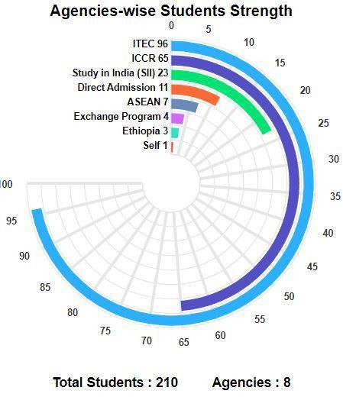
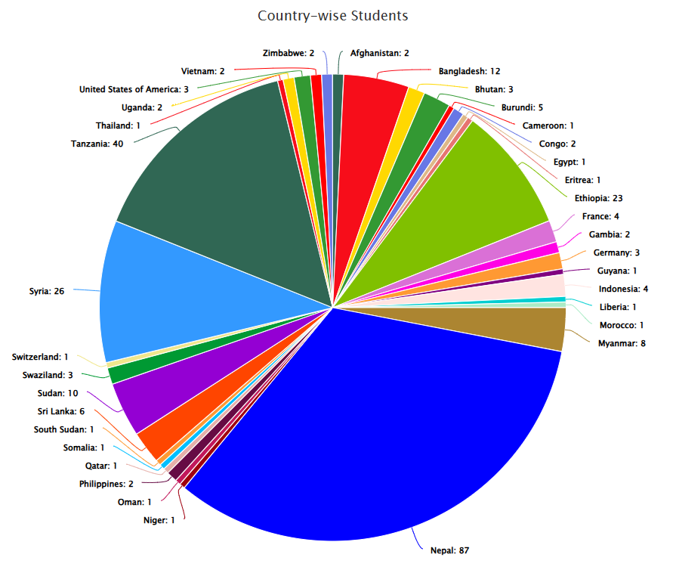
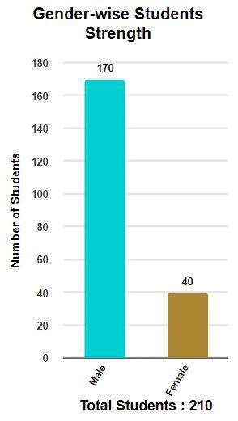
Foreign Students (at Present) at IIT Roorkee
>80 International students awarded degrees in 2025 Convocation.
>130 International students' admission in the Autumn Sem 2025-26.
Total Countries: 35
Year 2024
Total Students year 2025: 307
Year 2024

Slide 12


Double & Joint Degrees Partnerships
Dual/Joint Ph.D. Partnerships
University of Strasbourg, France
Loughborough University, UK
University of Lausanne, Switzerland
University of Groningen, Netherlands
University of Trento, Italy
Vrije Universiteit Brussel, Belgium
University of Alberta, Canada
Queens University, Canada
University of Saskatchewan, Canada
Ontario Tech University, Canada
Western Sydney University, Australia
Niigata University, Japan
National Tsing Hua University, Taiwan
Asian Institute of Technology, Thailand
Tribhuvan University, Nepal
University of Diponegoro, Indonesia
Dual/Joint Master’s Degree Partnership
Semiconductor Technology with three Taiwan Universities (NTHU, NTNU, NYMCTU)
Hydrology (Samarkand State University, Uzbekistan)
Associated Partner in Erasmus+ Master’s Program
Flood Risk Management (IHE/TU Delft, TU Dresden, University of Ljubljana)
Engineering for Environmental Sustainability and International Cooperation (EESIC) (University of Trento, Italy; Instituto Superior Técnico Lisboa, Portugal; Universitat Politècnica de Valencia, Spain)
10

Slide 13
IITR Student Exchange Programs
USA – Texas A&M University
USA - Yale University
USA – Purdue University
Czech Republic - VSB – Technical University of
Ostrava
Taiwan - Chang Gung University, Taiwan
Taiwan - NTHU, Taiwan
Taiwan - NTU, Taiwan (in Civil Engineering)
Germany - Technical University of Munich (TUM),
Germany
Germany - University of Potsdam, Germany (Co- PREPARE Student Exchange scholarship)
Germany, DAAD (Combined Study and Practice
Stays for Engineers from Developing Countries
(KOSPIE))
International Youth Exchange Programme (IYEP)
Australia - Australian National University, under the
‘Future Research Talent’ (FRT) Awards
France - École Polytechnique University, France (Internship Programme)
France - ESTP, France
Japan - Niigata University (NU), Japan
Japan - University of Tokyo, Japan
Singapore - Nanyang Technological University (NTU), Singapore, under the NTU-India Connect Research Internship Programme
Sweden - Kungliga Tekniska Hogskolan (KTH) Royal Institute of Technology, Stockholm, Sweden
Switzerland - Lucerne University for Applied
Sciences and Arts (HSLU), Switzerland
DUO-India Fellowship Programme
15

Slide 14
IITR International Engagements (Last one year)
Student Mobility (beyond IITR Student Exchange Programs)
More than 100+ students from IITR participated in semester exchange/internship programs institutes at partner institutes in various countries-
Australia (Future Research Talent Fellowship)
Canada (Mitacs Globalink Fellowship)
France
(Semester Exchange Program)
Germany (Kospie Internship)
Japan
(Semester Exchange Program)
Switzerland (Semester Exchange Program)
UK (Commonwealth Masters/Split-site Scholarships, Newton Bhabha Fund)
USA
(Fulbright Fellowship)
16

Slide 15
IITR International engagements (Last one year)
IITR received students on student exchange/internship programs from several partner institutes :
USA - MIT, Texas A&M
Japan – Niigata University
Germany -TUM, Leipzig University, University of Potsdam
Spain - Polytechnique University of Valencia
France - ESTP
Netherlands -University of Groningen
Canada - University of Alberta
Australia -Curtin University, University of Adelaide
Poland - Polish Academy of Sciences
Thailand - Asian Institute of Technology,
Nepal -Tribhuvan University, etc.
17

Slide 16


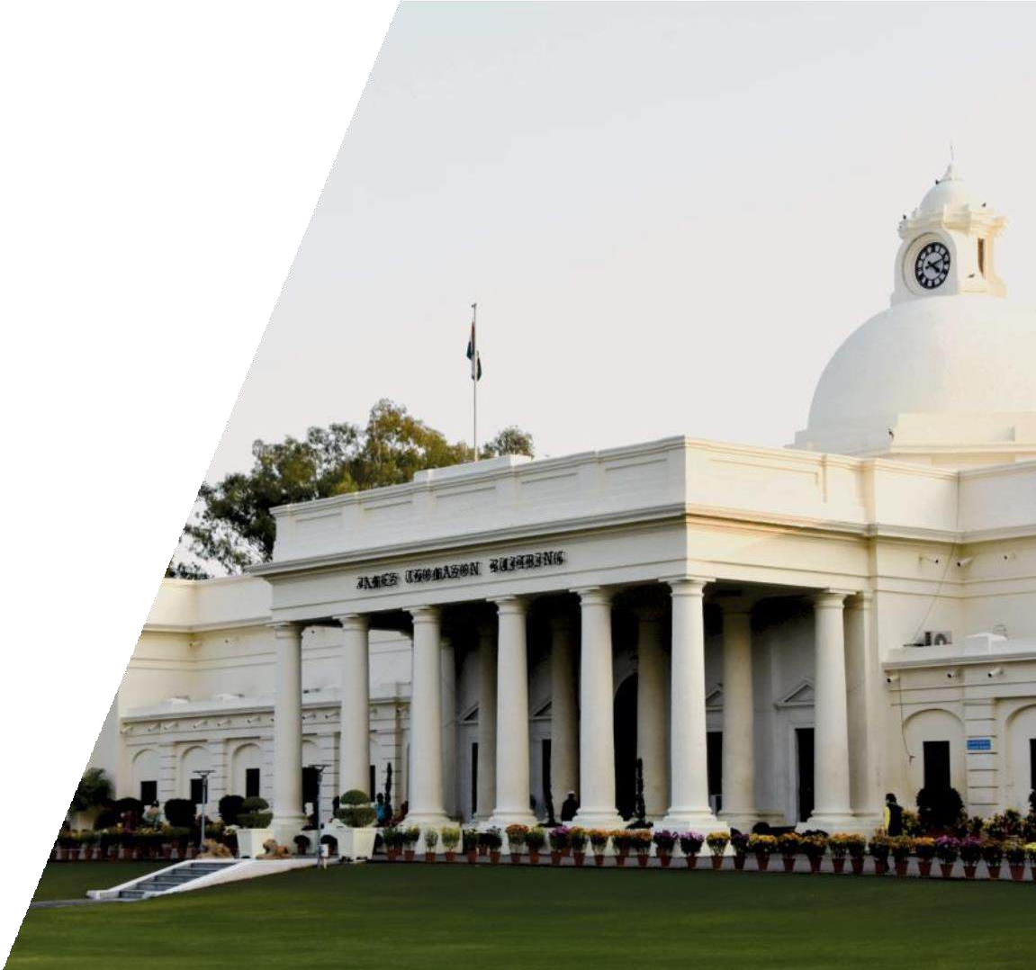












International Research Network Partnership
DST Africa Initiative
iitr
.ac.in

Slide 17

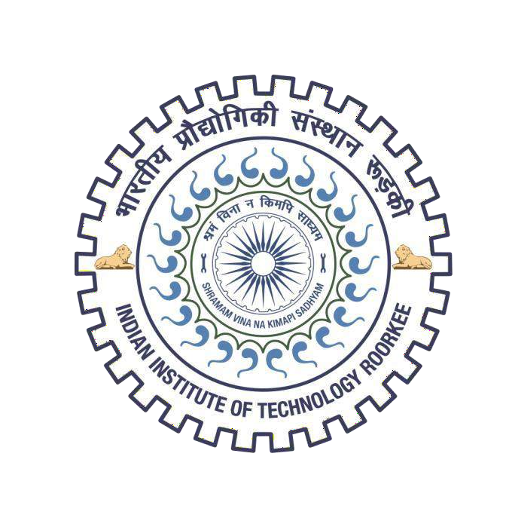










Joint International Projects
We look forward to build & strengthen the range of collaborative activities with foreign researchers.
Jointly Apply for Project Fundings
International Office of IIT Roorkee can Coordinate between Partner Universities
ERASMUS+
Europe Horizon
DST – International Division Bilateral Call
GCSMUS
Global Center of Spatial Methods for Urban Sustainability
Co-PREPARE
Collaborative Indo-German PRoject on Estimating and Predicting NAtural Hazards in the Himalayan Region
DST Africa Initiative
For effective leveraging the soft prowess of Science and Technology for our engagements with Africa DST proposed collaboration with World Bank to strengthen Africa Centres of Excellence (ACE's) established in African countries with the assistance of World Bank.
A New Passage to India
Towards an Indo-German Centre for Experimental Architecture and Material Culture (EAMC)
iitr.ac.in

Slide 18

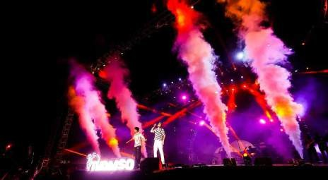



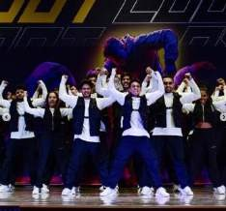

Cultural Activities in IIT Roorkee
Clubs in IIT Roorkee
Thomso is IIT Roorkee's premier cultural festival, attracting over 20,000 participants nationwide. It offers a platform for students to showcase their talents and fosters creativity and cultural exchange.
CultSoc (Cultural Society )
Music Club
Dance Club
Dramatics Club Hindi Language Club
Debating Society (DebSoc) and Quizzing Section
Standup Comedy Club
Kritika
SPIC MACAY (Classical
Music )
Fine Arts and Photography Section (FAPS)

Slide 19


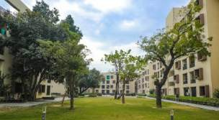
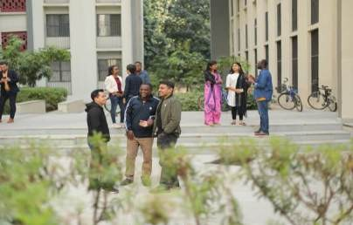
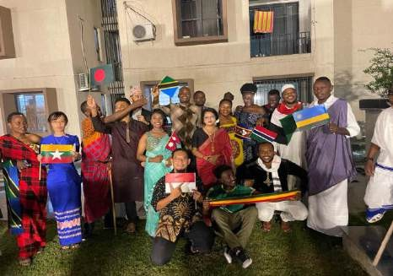
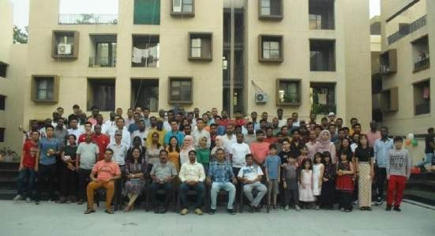
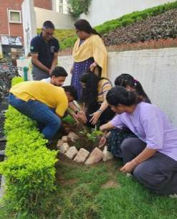
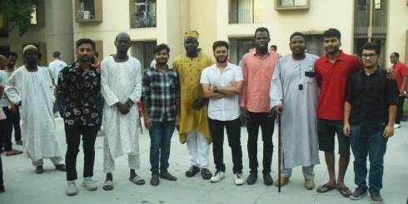
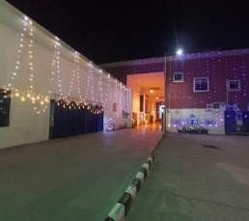
International Student Activities
Himgiri Apartment Foundation Day On 25th September
Vigyan Bhawan Day 10th July
Cultural
Activity
Cultural Diversity
Social Work

Slide 20

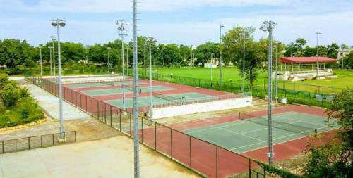
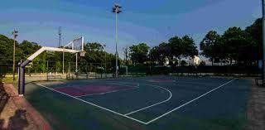
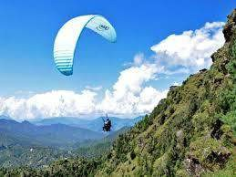
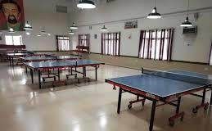

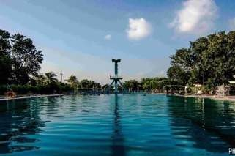
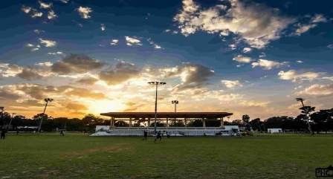
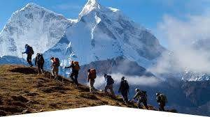

Sports and Other Related Activities
Athletics
Badminton
Basketball
Chess
Cricket
Football
Hockey
Lawn Tennis
Rowing
Squash
Swimming
Table Tennis
Taekwondo
Volleyball
Weightlifting
Yoga
Paragliding
Trekking
Rafting

Slide 21

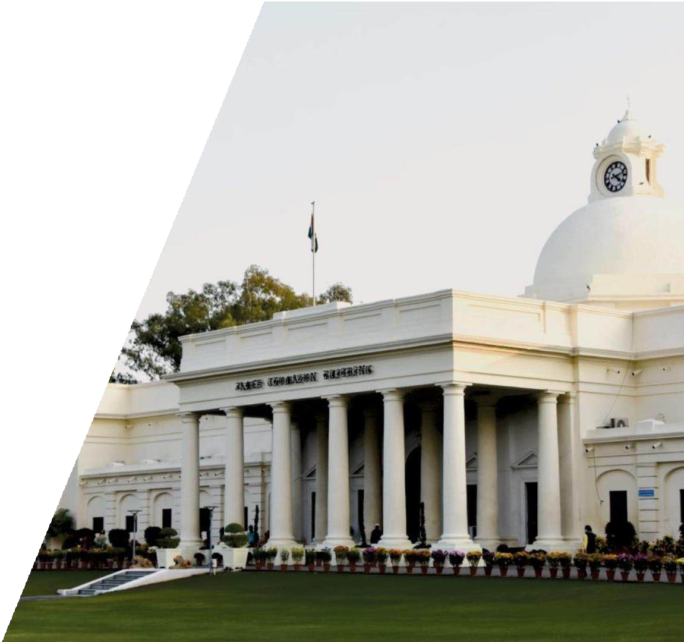
Earnestly looks forward to further strengthen global cooperation in the field of research & education
IIT Roorkee
Thank you
Please Visit to Our Dedicated website:
www.ir.iitr.ac.in
Prof. Karun Rawat
Dean, International Relations IIT Roorkee, India
Email to: dean.ir@iitr.ac.in
iitr.ac.in

